Slide 1
vedp 2.0: Preparing the commonwealth and its regions for HEALTHY growth
VEDP Welcome and Overview
August 23, 2018

Slide 2
VEDP OVERVIEW
Principal state economic development organization (EDO) for Va., with 118 employees
17-member governing board that provides continuity across gubernatorial terms
Focus on attracting, retaining, and growing traded-sector firms (>50% out-of-state sales)
E.g., corporate HQs, manufacturers, R&D centers, distribution centers, data centers
Retailers, local service providers benefit indirectly (most have 100% in-state sales)
Seven core divisions
Business Investment: works to secure business recruitment and expansion wins
Marketing and Communications: manages marketing of Va. and announcements
Research: provides data, analysis, and maps to support Business Investment team
International Trade: helps hundreds of companies expand their international sales
Workforce: regionally-based directors manage VJIP workforce grants program
Economic Competitiveness: develops strategies for economic growth and rankings
Incentives: manages incentives, including due diligence, reporting, clawbacks
Important support functions: external affairs, IT, fiscal, legal, human resources

Slide 3
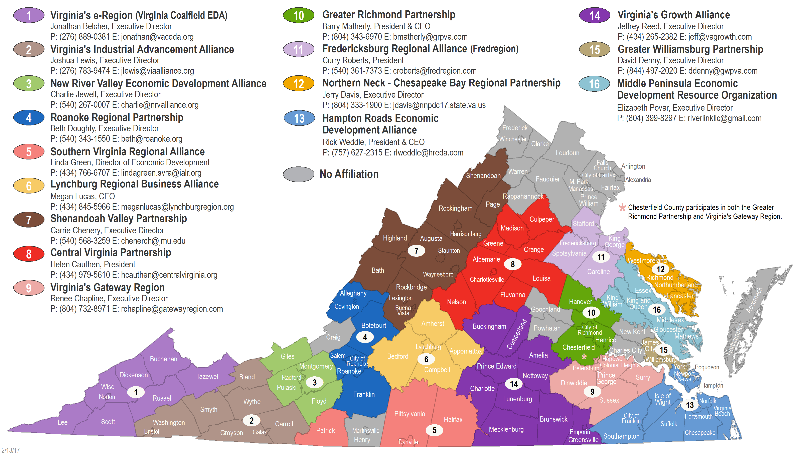
VEDP CONDUCTS ITS WORK IN CLOSE PARTNERSHIP WITH OTHERS, SUCH AS REGIONAL ECONOMIC DEVELOPMENT ORGANIZATIONS

Slide 4
VEDP’S PRINCIPAL ROLES IN VA’S ECONOMIC DEVELOPMENT ECOSYSTEM
Illustrative partners
(not comprehensive)
State Leadership Partners (e.g., Governor, General Assembly, Secretary of Commerce and Trade, Secretary of Finance)
VEDP’s Principal Economic Development Roles*
Local and regional economic developers
State, regional, and local chambers
Trade associations
GO Virginia / DHCD
Utilities
SCHEV, VRIC
Localities and local economic developers
Regional economic dev. organizations
VDOT, VDACS, DEQ
Utilities
Comm. on Business Dev. and Marketing
Business Development
Marketing and branding
Lead generation
Business recruitment
Business retention and expansion
Second-stage firm gardening
Incentives administration
Product Development
Economic competitiveness
Sector growth strategies
Site development
National rankings initiative
External affairs
GOVA leads
Int’l. Trade Development
Market research
Regional Export Program
Trade Show Asst. Program
Global Defense Program (GDP)
Virginia Leaders in Export Trade (VALET) Program
Workforce Solutions
Customized workforce recruitment and training incentive program (proposed)
Virginia Jobs Investment Program (VJIP)
Human capital development partnerships and initiatives
Higher education institutions (4-yr. and community colleges)
Regional workforce development boards
Recruitment and training contractors
Committee on International Trade
Port of Virginia
Virginia Maritime Association
State universities
U.S. DOC
U.S. SBA
GOVA leads
VEDP Support Functions (e.g., Research, HR, IT, Fiscal)
* The Code of Virginia also charges VEDP with the duty to “[e]ncourage the coordination of the economic development efforts of public institutions, regions, communities, and private industry.”

Slide 5
Our new 5-YEAR (FY19-23) strategic plan has been crafted with extensive stakeholder engagement
Economic development community (VEDA survey, meetings, webinars, workshops)
VEDP Staff (surveys, meetings)
National Rankings Initiative (partnership of VEDP, Virginia Chamber, and
Va. Tech Pamplin)
Economic development strategy and action plan (McKinsey/IBM Project guided by regional EDO CEOs and the largest NOVA localities)
Draft concepts and ideas
Feedback-gathering efforts
Expert Panel
General Assembly leadership (interviews)
VEDP Board
Committee on Business Dev. and Marketing*
Steering Committee
Selected McAuliffe administration leaders (e.g., SCT) (interviews)
Committee on International Trade
Rural “Think Tank” Working Group
REDO CEOs (group meetings)
* With timing of committee appointments and Amazon HQ2-related scheduling challenges at VEDP, this committee was not consulted as extensively as some of the other groups

Slide 6
VA’S ECONOMIC COMPETITIVENESS: ABUNDANT STRENGTHS PARTIALLY OFFSET BY CORRESPONDING WEAKNESSES
Strengths
Weaknesses
Top 10 rankings for educational attainment, higher education, K-12
Wide range of attractive small sites (<25 acres) in some regions
Geographic location (e.g., Mid-Atlantic, contiguous with Washington, D.C.)
Below average state/local tax burdens for existing firms
Impressive Port of Va., NOVA airports, and spaceport on the Eastern Shore
Diverse range of high-quality employers and headquarters
Impressive range of federal laboratories, higher ED research
Generally high-quality, high-speed broadband in served areas
Lack of a customized workforce incentive program offering; insufficient CS pipeline
Meager inventory of large sites (especially 100+ acres) and certified sites
Site development timeline/cost challenges due to lack of investment and topography
Uncompetitive state/local tax burdens for new investment*
Metro, traffic congestion challenges in NOVA; road limitations in ROVA
Unusually high reliance on federal government-related activities
Limited commercialization of intellectual property
Large swaths of Virginia have no broadband access
* VEDP has identified a potential error in KPMG’s tax rankings that, if confirmed and corrected, could improve Virginia’s state/local tax burden ranking for new, capital-intensive manufacturers from nearly the worst in America to the mid-20s
Source: U.S. News & World Report; Tax Foundation/KPMG; interviews with site consultants; McKinsey; VEDP analysis

Slide 7
With input from GA leaders, admin., and stakeholders, we crafted five TRANSFORMATIONAL goals for Virginia, VEDP
Robust State Job Growth: Over the next several years, position VA to achieve a growth rate (measured by employment and median earned income of workers) among that of the top 5-10 states in the US
Every Region Wins: Ensure that every region participates in the growth of the Commonwealth (i.e., all with positive growth in employment, median earnings)
Best State for Business: Restore Virginia to its previous leadership position near the top of the national business climate rankings (i.e., average in top 3-5)
Top State EDO: Reestablish VEDP as one of America’s premier state EDOs (to help accomplish the top three transformational goals)
Super Collaborator: Exhibit collaboration and coordination as hallmarks of VEDP (i.e., place a central focus on the “P” in VEDP)

Slide 8
Virginia’s historical growth patterns have been unevenly distributed across regions
Employment CAGR,
2006-2011, %
New jobs, k
New jobs, %
Employment CAGR,
2011-2016, %
New jobs, k
New jobs, %
Region
Northern Virginia
1.3%
81.5
104%
0.9%
60.4
44%
Rest of Virginia
0%
-2.8
-4%
0.6%
75.6
56%
Greater Williamsburg Partnership
0.6%
2.3
3%
0.8%
3.1
2%
Central Virginia Partnership for Economic Development
0.6%
4.5
6%
1.0%
8.0
6%
New River Valley Economic Development Alliance
0.5%
2.1
3%
0.7%
3.1
2%
Greater Richmond Partnership
0.4%
9.0
11%
1.6%
41.8
31%
The Lynchburg Regional Business Alliance
0.2%
1.2
2%
-0.1%
-0.6
0%
Hampton Roads Economic Development Alliance
0.1%
3.8
5%
0.4%
14.1
10%
Roanoke Regional Partnership
0.1%
0.6
1%
0.2%
1.2
1%
Virginia’s Growth Alliance
-0.1%
-0.3
0%
-0.2%
-0.6
0%
Fredericksburg Regional Alliance
-0.1%
-1.0
-1%
1.0%
8.4
6%
Shenandoah Valley Partnership
-0.2%
-2.8
-4%
0.5%
6.4
5%
Northern Neck Chesapeake Bay Region Partnership
-0.5%
-1.1
-1%
-0.6%
-1.4
-1%
Virginia Coalfield Economic Development Authority
-0.7%
-2.9
-4%
-3.1%
-11.2
-8%
Middle Peninsula Economic Development Resource Organization
-0.8%
-1.7
-2%
0.2%
0.4
0%
Virginia’s Industrial Advancement Alliance
-1.1%
-4.8
-6%
0%
0.1
0%
Virginia’s Gateway Region
-1.3%
-4.3
-5%
0.7%
2.2
2%
Southern Virginia Regional Alliance
-1.5%
-7.3
-9%
0.1%
0.5
0%
Total
0.5%
78.7
100%
0.6%
135.9
100%
Source: BLS; Moody’s Analytics; McKinsey analysis

Slide 9
three TYPES of Strategies HAVE BEEN developed to accomplish the five TRANSFORMATIONAL goals
Cultivate target industry growth clusters
Push new boundaries as a U.S. leader in information technology
Assemble a world-class transportation and logistics hub
Position Virginia’s manufacturing base to be future ready
Create bus. services and ops. centers of excellence (e.g., HQs)
Capitalize on Virginia’s unique assets to become a leader in promising disruptive technologies (e.g., unmanned systems, genomics, personalized medicine)
A
Improve VA's economic competitiveness
Strengthen Virginia’s human capital development engine
Assemble an ample, strategic portfolio of project-ready sites and buildings across Virginia
Rigorously assess and steadily improve Virginia’s state, regional, and local economic competitiveness
Leverage public-private partnerships to strengthen Virginia’s digital infrastructure (i.e., broadband)
Place a special focus on achieving growth in Virginia’s rural regions and small metros
B
Enhance VEDP’s capabilities
Cultivate world-class execution at VEDP
Implement robust marketing/branding, lead generation, and site consultant cultivation programs
Strengthen and expand business and international trade development programs
Become a national leader in incentives administration
C

Slide 10
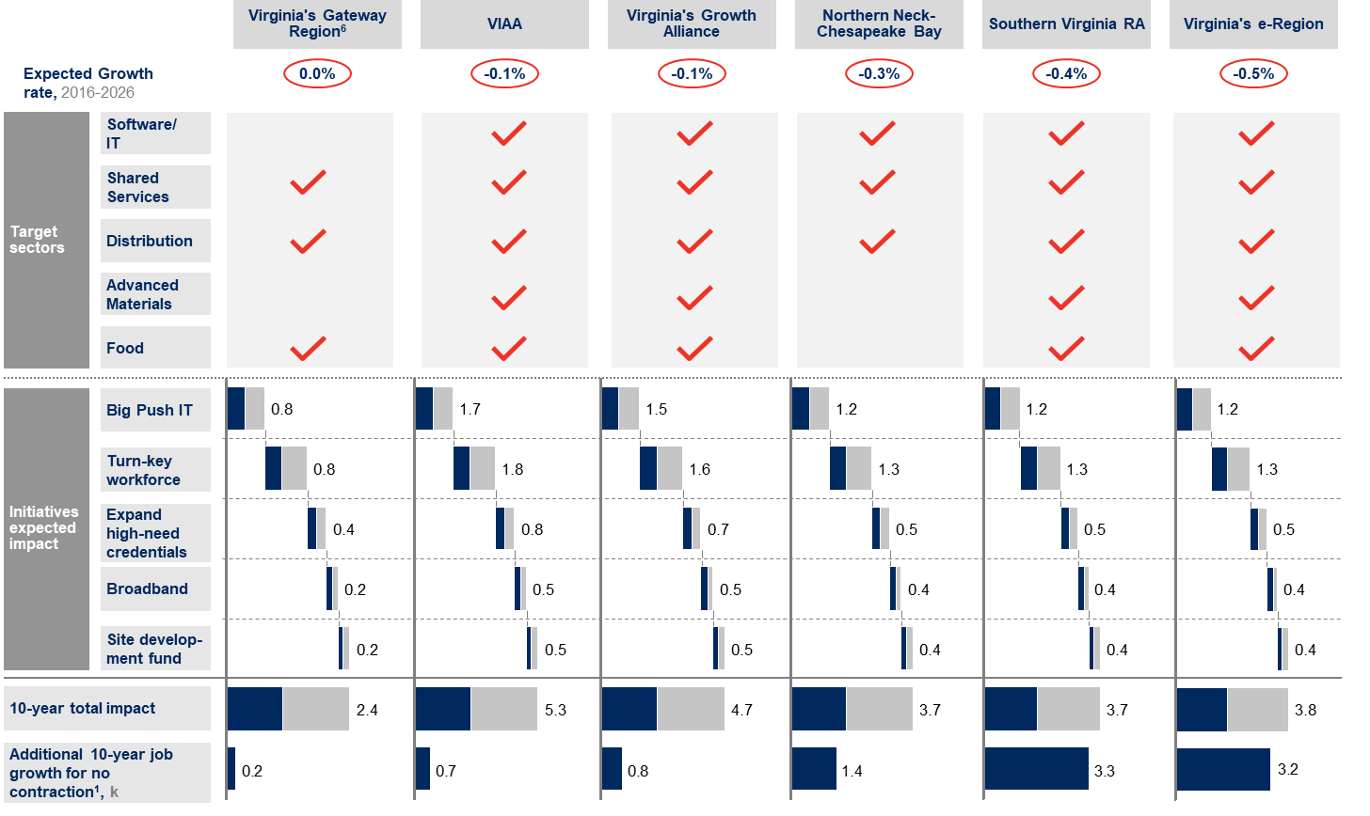
These strategies ALSO are designed to ensure that every region wins
1 Total jobs needed over 10 years to ensure region not subject to economic decline; 2 Analysis shows limited opportunities to capture value without specific synergies from company in question; 3 Quality of product is exceptional, but costs reflect that; 4 Cost is low, with room to improve on quality; 5 An attractive balance of competitive costs and quality; 6 Plus chemicals
SOURCE: IBM-GLT, EMSI, Moody’s Analytics, BLS

